Slide 1

A Temporal Approach for Large Scale Automatic News Extraction
Candidato: Luigi Pio D’Onofrio
Matricola: 462576
Relatore: Dott. Valter Crescenzi
Correlatore: Prof. Giovanni Grasso

Slide 2

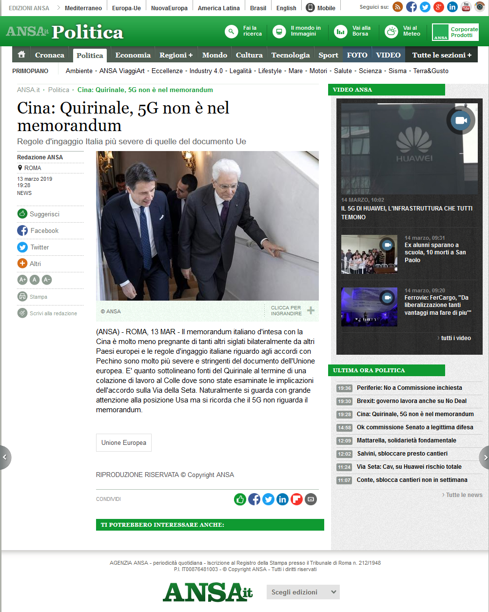
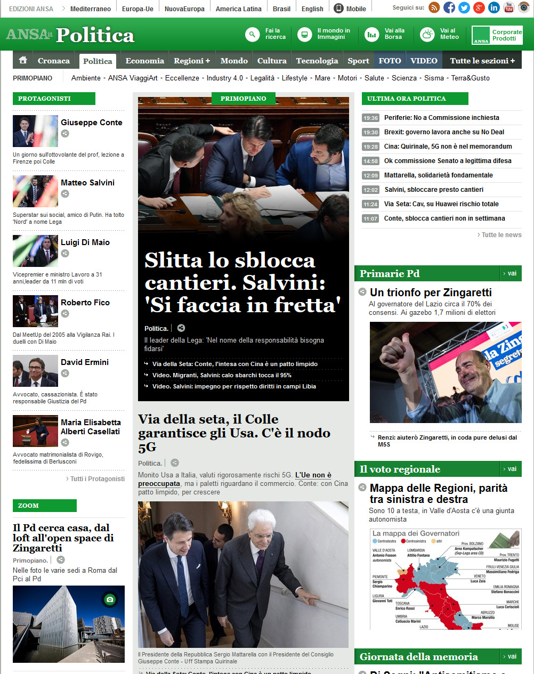
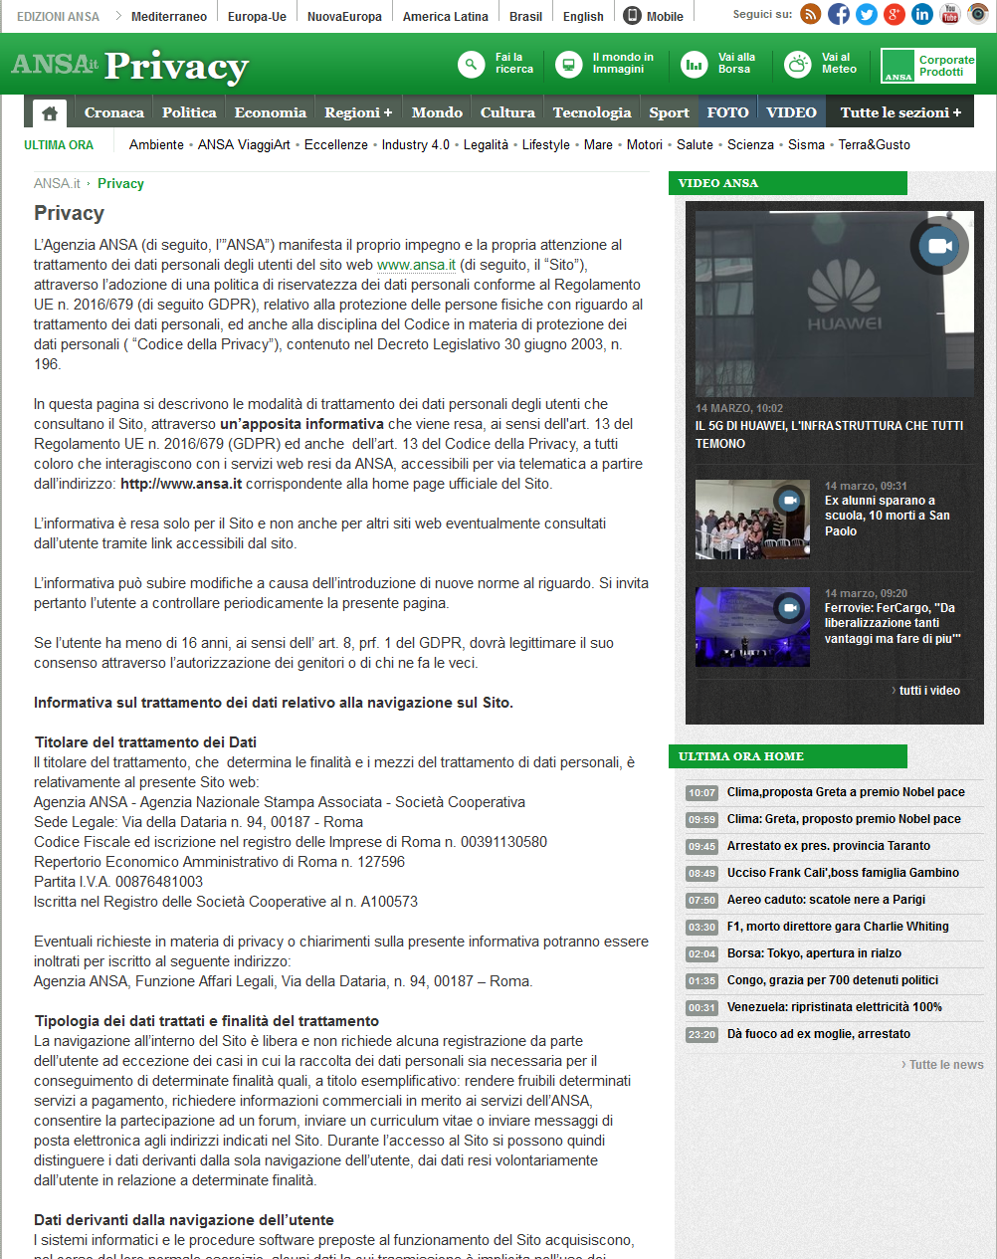
News Domain
Article
Searching news has become "natural" for everyday life​
More and more services and sites use news for several reasons
The domain we are operating in is quite simple
It has few classes of elements
It has well differentiated behaviours for these classes
Section
Other

Slide 3

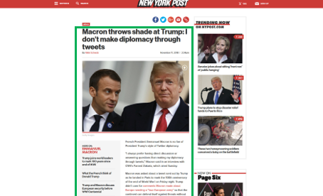
Problem Definition
Problem: archiving all the article pages from many news sources, automatically, at scale​
News sources are
A considerable amount
Very heterogeneous
Challenging Problem at scale
few head can be covered with costly per-site ad-hoc solutions​
many more long tail sites cannot be covered with such solutions
Human Supervision means cost​s, which are not affordable if we want to scale
Provide homogenous data to do extraction
Per-site setups (parameters and configurations)
…Along with technological costs as well

Slide 4
A Temporal Approach​
First we need to understand the nature of each page
Classification task
Very distinguishable behaviors:​
Article: exists in the site for a limited time at a certain depth​
Section: exists almost forever at a certain depth​
Depth: means crawling depth​
Can we automatically pick up some temporal signals that can give us a hint about the nature of a page?​
We are about to introduce the Stability of an URL​

Slide 5
Snapshot
A [crawling] snapshot is a set of pages from a source gathered at a certain time
We need evidence of the temporal behaviour of pages from snapshots
too slow: evidence is lost because an article could appear (or disappear) before you see it
too quick: consecutive snapshots identical, not providing any new information (wasting resources)
Unbiased crawler: doesn’t know anything about News domain
Simple breadth-first crawler at max depth (2)
Totally blind in this problem definition (>> design choice revisited later)
Fixed interval between snapshots (about 1 hour)
Notes:
Poco controllo sul numero di pagine scaricare, dunque tempo e spazio sprecati.

Slide 6
What is Stability?​
Stability: degree of belief to find a certain URL at a certain depth in the next set of sample pages from a news source snapshot​
It is a frequency between 0 and 1:
0 means that we'll not find the URL in the next sample, for sure
1 means that we are sure we'll find the URL in the next sample
An example:
URL​ | Stability​
http://A.html​ | 1.0​
http://B.html​ | 1.0​
http://C.html​ | 0.33​
http://D.html​ | 0.5​
http://E.html​ | 0.5​
http://F.html​ | 0.33​
http://A.html​
http://B.html​
http://C.html​
http://D.html​
http://A.html​
http://B.html​
http://E.html​
http://D.html​
http://A.html​
http://B.html​
http://E.html​
http://F.html​
Snapshot 1
Snapshot 2
Snapshot 3

Slide 7
Stability
The performance trend is growing over time
Pros
Tremendously simple​
It represents a real-world aspect
Gives a quite big hint about the nature of a page:​
Article: after a transitory regime, it will have a very low Stability percentage​​
Section: after a transitory regime, it will have a very high Stability percentage​
Cons
Unpredictable regime reaching time
Depends on crawling depth
It is not able to distinguish between Sections and Others
Notes:
Depth = 2
220 snapshots
Golden fatto a mano
Sampling frequency 1 ora
Semplice decision tree

Slide 8
Link Occurrences Behaviour
Let’s now have a look at the content of a page, intended only as its Link Occurrences, which have pretty peculiar behaviours
A Link Occurrence is a particular instance of a link
There may be more than one in the same page
We can have a Link to a page p if there is at least one link occurrence pointing to p

Slide 9
Hypertextual References Dynamicity
Definition: Hypertextual References Dynamicity of a link l is intended as the total amount of movements across snapshots made by all the link occurrences leading to l in each page​
According to this aspect we can state that: ​
Article’s occurrences are dynamic, i.e., characterized by frequent movements across all the pages
Section’s occurrences are relative static: characterized by steady behaviour​
They should not change their position too often due to their purpose: guide the navigation​

Slide 10
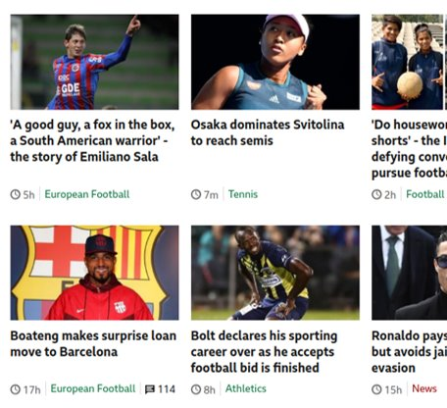
Hypertextual References Dynamicity
Articles
Updates are frequent: article detection accuracy quickly increases​
But if there are few well-temporized items performance are not great
Pros
It can catch a real-world behaviour: hops of hypertextual references
Faster than Stability
Sometimes better than Stability
Cons
Cannot distinguish a Section from an Other page​
They are both steady​
Heavily depends on content presentation
Articles

Slide 11

Multi-Feature
S HRD
The idea is that using all the features will lead to better results even in case of some misleading features
To validate this approach we used a voting system
We trained a classifier for each combination of features and the most voted class will be the chosen one
For this study we used decision trees
Simple to reason on them
Fast training
Tremendously simple approach

Slide 12
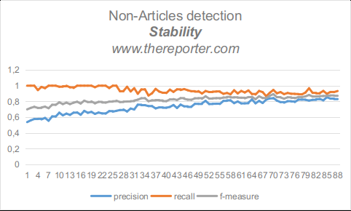
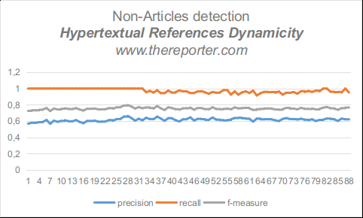
Multi-Feature
The news source in the provided example had
a good update frequency
a pretty bad link occurrences temporization
Hypertextual References Dynamicity was misleading in this case
However, using a multi-feature model led to a better result
Pros
Classification is more stable
Classification is not affected by misleading features
We can avoid features selection phase
We can obtain a performance boost in a lot of cases
Cons
Introduces overhead
Still cannot distinguish between Section & Other

Slide 13
Section Driven Crawling
Phase 1: EXPLORATION
We propose a two phase crawling to achieve 3-classes classification
We need to distinguish between Sections and Others
Exploration
Home page is the entry-point
Article vs. Non-Articles classification
Low depth
Update knowledge and parameters
Until phase-switch condition
Exploitation
Exploit previously obtained information to distinguish between sections and other
New feature: Links to Articles Count >>
Now the system is aware of the source it is operating on
Sections are the new entry-points
Update knowledge and parameters
Phase 2: EXPLOITATION

Slide 14
Links to Articles Count
Section
Exploits the amount of links pointing to articles
A section has a lot of links to articles
An other has very few links pointing to articles
So in the exploration phase we care more to identify articles pages
This way we can exploit this information to refine our knowledge in the exploitation phase
Other

Slide 15
Section Driven Crawling: performance
After a transitory regime (24 hours in this case) we have the phase-switch
In our case we set up a threshold for f1-measure on articles
After the phase switch we exploit all the previous obtained knowledge about articles to spot Sections and Others
Results are pretty good compared to previous ones
We have complete knowledge of what is an article, a section or an other

Slide 16
Experiments: Stability
Experiments on 150 snapshots on lots of news sources at depth 2
Results with those peaks show that Stability depends on
Global update frequency of the website
Section size
Reachability of Article Graveyards

Slide 17
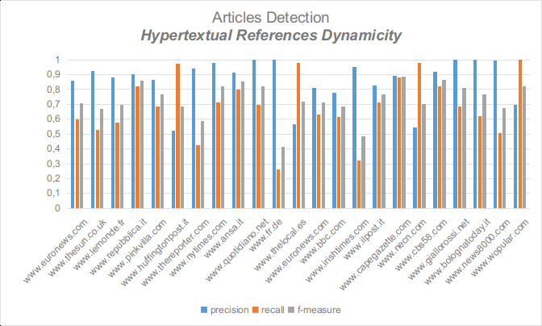
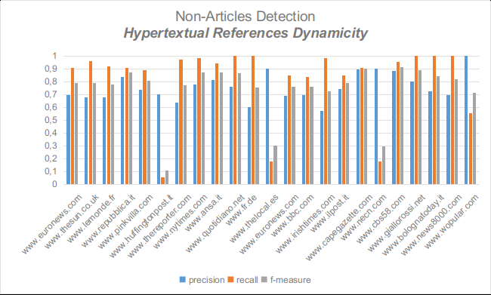
Experiments: Hypertextual References Dynamicity
Experiments on 150 snapshots on lots of news sources at depth 2
Results with those peaks show that Hypertextual References Dynamicity depends on
Content presentation of the page
Page elements temporization

Slide 18
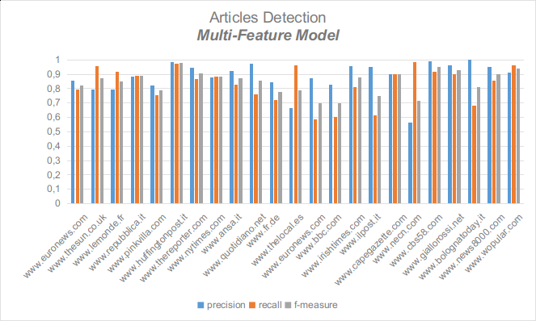
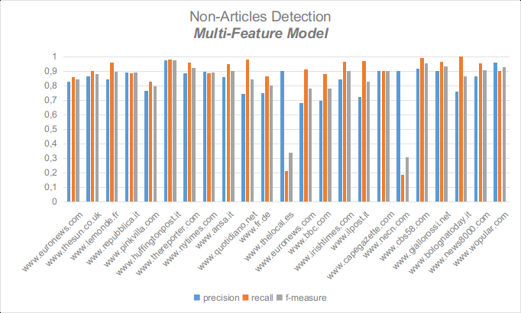
Experiments: Multi-Feature
Experiments on 150 snapshots on lots of news sources at depth 2
Less peaks in performance than using a single feature-model
Each website can exploit the most convenient feature or (set of features) for it
Despite of the use of only two features the results were good

Slide 19
Conclusions & Future Works
We studied this approach and its feasibility
It is feasible
It works
It is cheap
We made a simple cost analysis for storage savings using a common cloud storage service
Unbiased crawling vs. Section Driven Crawling
93% in savings achieving same performance
Low depth
… but we need more
Scale on an higher amount of websites
more features
Temporal
Non-Temporal
Refine the architecture to scale more and more
More unsupervision!
Purely unsupervised algorithm
System-level parameters setup only
(more) Site-level parameters are dynamically adjusted

Slide 20

Grazie a tutti per l’attenzione!

